Slide 1
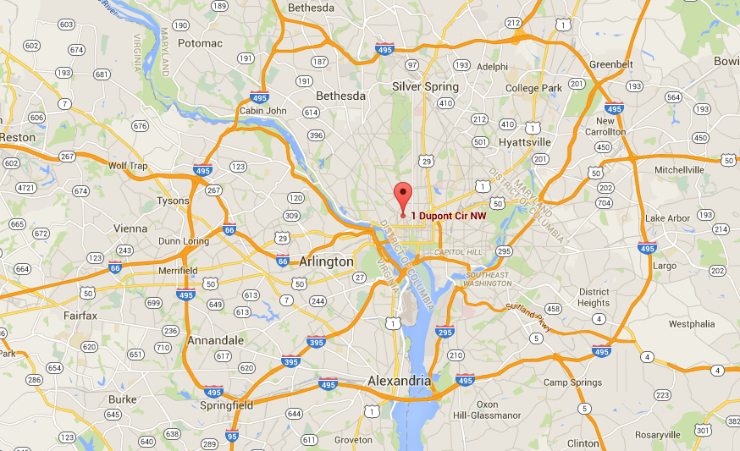
VFA Community
College

Slide 2
Federal Community College Success Rate
--A POP QUIZ
19.8% Federal 150% completion
38.5% Federal 150% completion + Transfer
25.1% Federal 200% completion
53.4% 150% completion+transfer+still enrolled
All of the above
19.8%
38.5%
25.1%
53.4%
All of the above
Meaningful
Utility
First-time, full-time cohort represents less than half of new Students
at community colleges

Slide 3
VFA Federal Graduation Rate
53.6% graduated,
transferred or
still enrolled

Slide 4
Who is included in our Federal Rate?
Only First-time full-time students
3,915 out of 29,015 new students
13.5% of our new students

Slide 5
VFA Cohorts vs. IPEDS Cohort
VFA Main Cohort
Students who began taking credit or developmental education at your institution in the fall of the cohort year; new to your institution
Credential Seeking
Students in the Main Cohort who earned 12 or more credits in two years
First Time in College
Students in the Main Cohort who were degree seeking and first-time in post-secondary education
Main Cohort
Credential Seeking
First Time
in College
IPEDS
IPEDS Federal Graduation Rate
150% time, full-time, degree seeking, first-time in post-secondary education

Slide 6
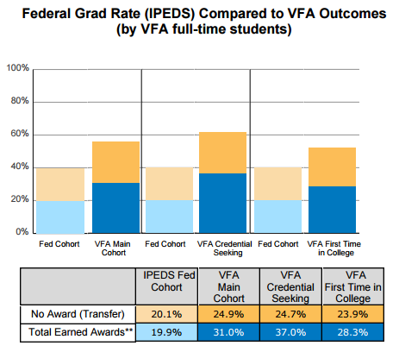
VFA Six-Year Outcomes vs. IPEDS 150% Time Outcomes
The above graphs represent the average data for all colleges that participated in the VFA.

Slide 7
Federal Graduation Rate and VFA community college VFA rates
NOTE: Federal rate is First-time, full-time students after 3 years, VFA rate is all students after 6 years

Slide 8
Federal Graduation Rate and VFA community college VFA rates
NOTE: Federal rate is First-time, full-time students after 3 years, VFA rate is all students after 6 years

Slide 9
Conclusion
VFA community college federal graduation rate, is an incomplete measure of how we are serving students.
VFA 6-year outcomes are better because:
We capture more students—Federal rate was only 13% of our entering class in 2008
We capture more outcomes
We have a longer time-horizon, to allow part-time students a chance to complete
We can look at outcomes for different populations
VFA success rate* for all incoming students is 64.4%
*VFA community college success rate is the percent of students who either completed a credential or
transferred within six years, or were enrolled in their 6th academic year.

