Slide 1
VFA Year Four January 1 – December 31, 2017
A Returning User’s Update
Notes:
Contact: VFA@aacc.nche.edu

Slide 2
VFA Overview
FOR community colleges
The Voluntary Framework of Accountability
is the first national system of accountability
specifically
for community colleges
by community colleges.
BY community colleges

Slide 3
Goals for VFA in 2017
Make the VFA the principle accountability system for community colleges
Better data to inform public policy and advocacy
Nation- and state-wide reports
Continually increase utility
Value-added metrics for accountability (using data to measure performance and make better decisions)
National benchmarking for good practices
Opportunity to streamline reporting / relieve IR burden
Ability to tell a better, more robust story
accountability
Utility

Slide 4
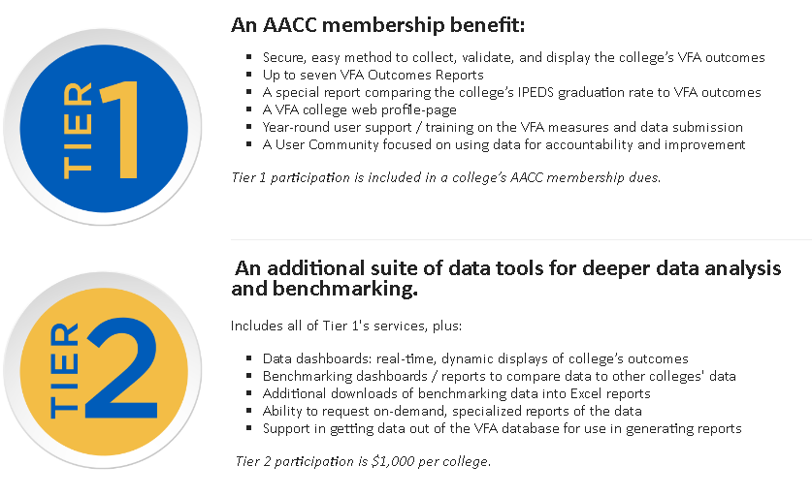
New VFA Membership Model
accountability
Utility

Slide 5
Membership FAQs
When do sign-ups open?
Wednesday, February 1
What if my college is not an AACC member?
Returning VFA participants may be able to continue their VFA participation at a different price structure. Email: VFA@aacc.nche.edu
What if my college purchased a multi-year membership that covers 2017?
Pre-paid dues: AACC has set-up your 2017 Tier 2 participation. Complete details sent to Key Contact & purchaser
Did not prepay due: Sign-up using the online system
accountability
Utility

Slide 6
Updates to VFA Metrics

Slide 7
Reporting VFA
Six Year Cohort
Developmental Education Progress Measures
Two-Year Progress Measures
Six-Year Outcomes Measures
Two Year Cohort
Cohorts
Main
Credential Seeking
First Time
In College
Measures
CTE Cohort
Career & Technical Education Measures
ABE Cohort
Adult Basic Education Measures
Notes:
VFA Metrics:
Student Progress & Outcomes:
Two Reporting Timeframes (Cohort Years):
Six Year Cohort: Developmental Education Progress & Six-Year Outcomes measures required; Two-Year Progress measures optional
Two Year Cohort: Two-Year Progress measures required; Developmental Education Progress measures optional [Six-Year Outcomes measures not applicable]
Three Cohort Types: Main Cohort, Credential Seeking Cohort, First Time in College Cohort
Career & Technical Education (CTE)
CTE Profile: required for all colleges with CTE
CTE Completer/Leaver Cohort: required to report all data college is able
Adult Basic Education (ABE): optionally reported
The measures gauge student progress and outcomes from pre-collegiate preparation (such as developmental education and Adult Basic Education), through progress to completion and transfer measures. They are also inclusive of workforce outcomes for career and technical education.

Slide 8
VFA Cohorts
VFA Main Cohort
All fall-entering students – including those with varied start dates – should be included in the cohort
Credential Seeking Cohort
Students must complete at least 12 semester credits (or equivalent) at your college or earned a credential within the first two years
No longer includes:
Credits transferred in
Credits earned while in high school
PLA credits
Y2 , Y3, Y4…
Cohorts

Slide 9
Developmental Education
Clarified VFA referral method: “Referred”
Update to Attempted Developmental Education metric
Referred students only
Must report both Total Developmental Need population as well Referred population -- according to chosen referral method
By course-taking: this count will equal 0
By referral: this count will equal the Total Dev Need count
By Combo: this count ≤ Any Dev Need count
Option to report developmental need by program
Y2 , Y3, Y4…
Remedial Education

Slide 10
Two-Year Progress
New Metric: Earned Zero Credits First Term
Number of students in the cohort who were enrolled after the add/drop date in the first, fall term who failed to successfully complete at least one credit (or credit equivalent) in that term.
Y2 , Y3, Y4…
Early
Indicator

Slide 11
Successful Completion of Credits
based on institutional practice of completion, as long as the student earned a letter grade of C- or better (or P if the course is offered as pass/fail)
College may choose to use any C grade (C-, C, or C+)
This information will be collected on the Set-up Data Input page
Y2 , Y3, Y4…
Successful Completion

Slide 12
Updates to VFA Data Collection

Slide 13
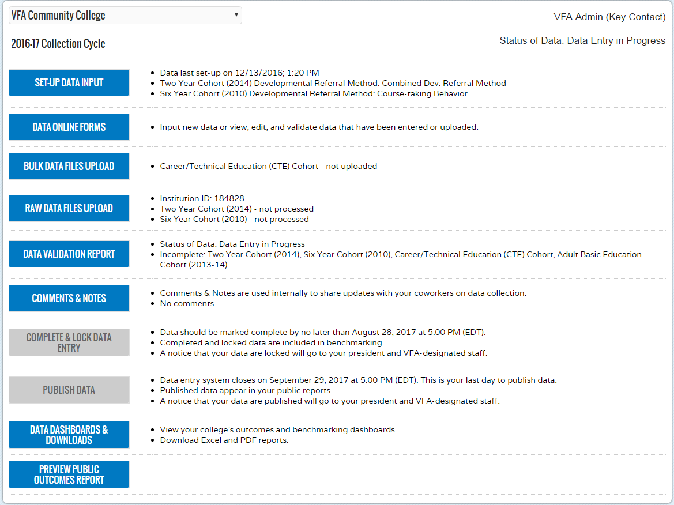
Data Landing page
Notes:
VFA Workflow
All colleges must first configure how they will do data entry
Depending on configuration, allows for data upload (bulk and/or raw files)
All data entry methods populate online data entry forms and allow viewing and/or editing raw data
Validation through online data entry forms; summarized in Data Validation page
After data entry is complete, mark data for review. System allows user to add notes for approvers.
Publish Data – only available to users with access and can only be done if no errors exist

Slide 14
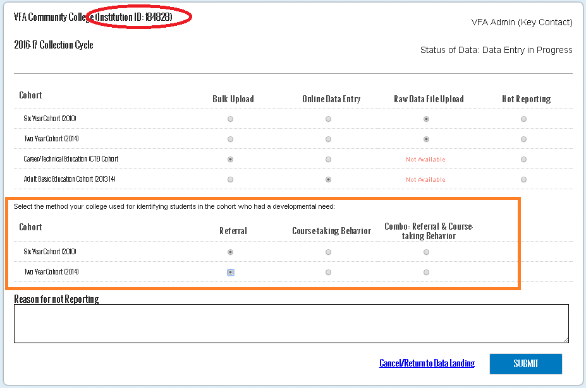
Set-up Data Input
Notes:
Ability to configure and administer your data collection; workflow
Configure what data you will be reporting and system will grant access to different sections accordingly
Also used during error checking.

Slide 15
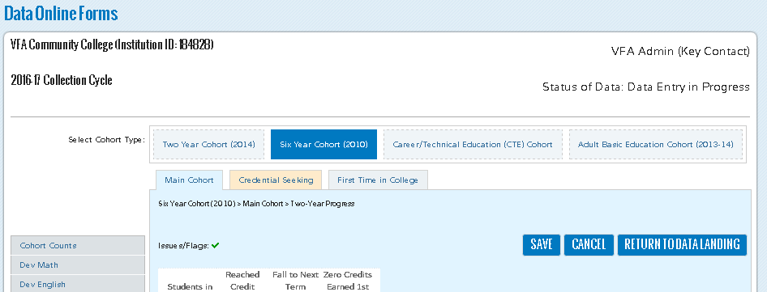
Online Forms
Notes:
VFA Online Data Collection Forms
Accordion–style condenses the forms to only see data you’re currently entering (by disaggregation)
Real-time validation on page (right column indicators)

Slide 16
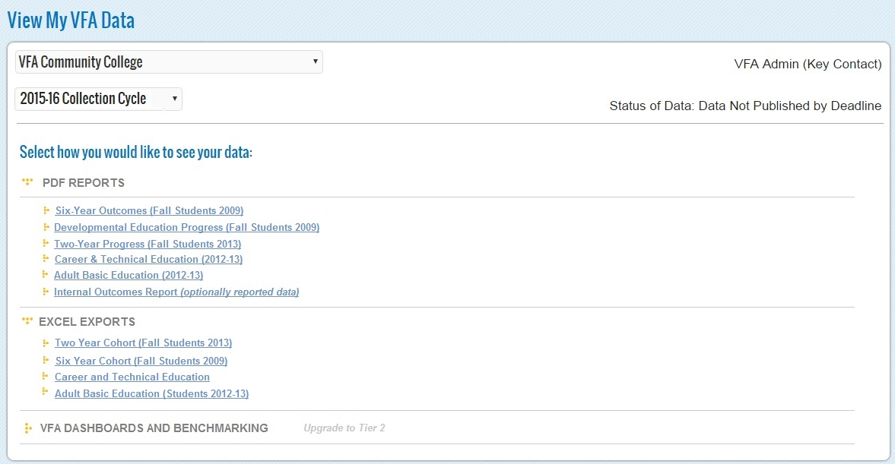
VFA Outputs
Notes:
Export to Excel

Slide 17
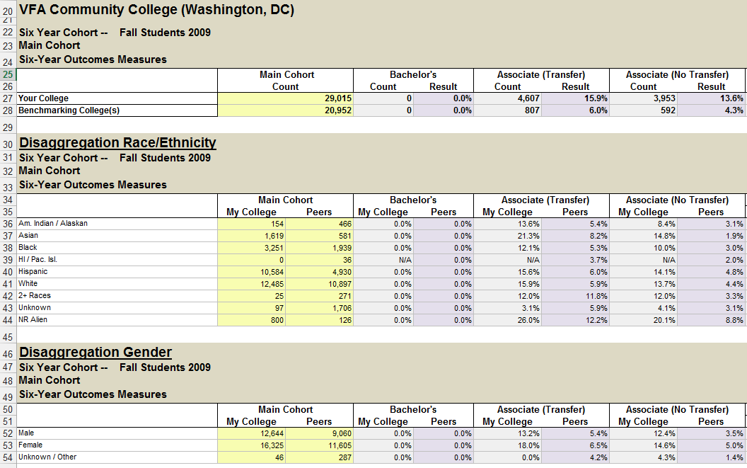
VFA Benchmarking Export
Notes:
Export to Excel

Slide 18
Notes
Sign-ups open February 1
Data collection begins in March
Data due August 28
Contact VFA at VFA@aacc.nche.edu
Y2 , Y3, Y4…
principle accountability system

Slide 19
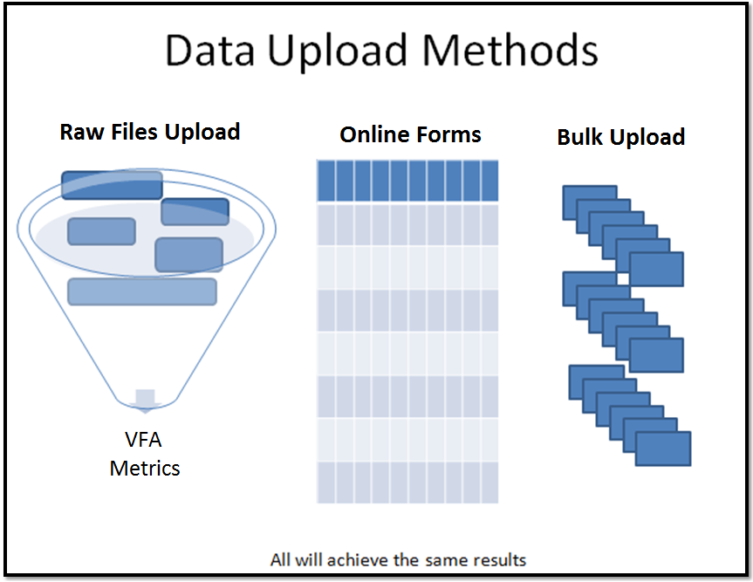
Notes:
Three methods for reporting your college’s VFA data
Raw Files Upload
Student- and course-level data is collected, translated & loaded into the data online forms and VFA database tables.
The underlying data is deleted after data collection closes. AACC will not store student unit record data.
Manual online data entry of VFA metric counts
Bulk upload of VFA metric counts

